Slide 1
My trip to Cleveland, Ohio
Who am I, where & why did I go & what now?
Notes:
Explain my teaching history briefly

Slide 2
education is a process of living, not a preparation for future living
John Dewey
Notes:
School Shouldn’t Hurt. School’s shouldn’t be results factories.
School should be relevant & enjoyable in the here and now whilst preparing individuals for the future.

Slide 3
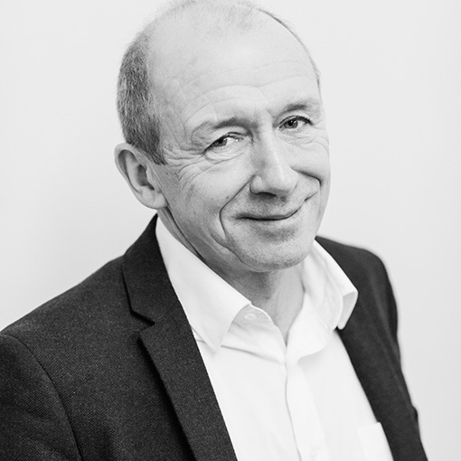

It all began with….
David spoke of ……
The MTC (The Mastery Transcript Consortium) which helps to create rounded student profiles by providing a broad and deep curriculum.
This is recorded in a website-based 'landing page'
He spoke of the ideas of placing developing and presenting the ‘Whole Child’ at the core of schooling
David Price
educationforward.co.uk
Notes:
Please will you give me the information about the upcoming meeting?

Slide 4


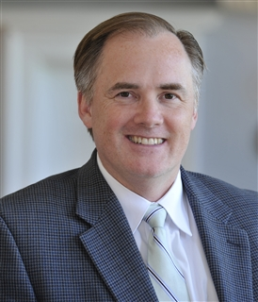
Then….
David Price
Scott Looney
Notes:
up by the Governors at BISSC with a decision to be 'part of the conversation'

Slide 5

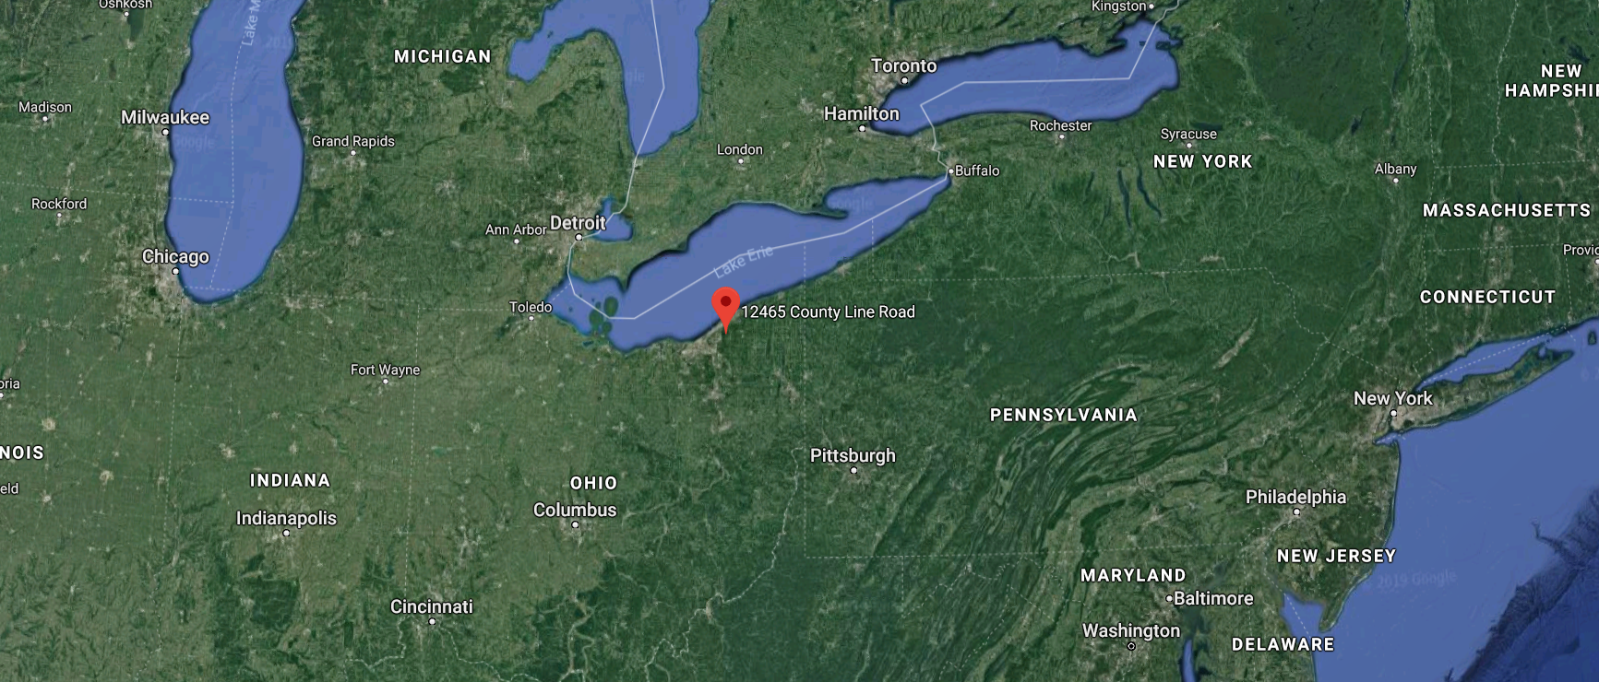

Happy
Teachers as facilitators not lecturers
Purposeful
Engaged

Slide 6

What is the mTC?
The MTC Mission
A growing network of state & private secondary schools around the world
Creating a high school transcript (UCAS application/linkedIn profile) that reflects the unique skills, strengths, and interests of each learner
Supports educators in facilitating the kind of learning they know is best for students.
The MTC Vision
Re-inventing how students prepare for college, career, and life.
https://mastery.org/about/about-us/

Slide 7



What exactly is Mastery?
Mastery is the bold notion that learning should be deep, enduring, creative, transferable and, most importantly, used to solve complex problems in the world.
Hawken is built around three overarching educational concepts:
Courses and programs organised around real world problem solving.
A mentorship approach to instruction allowing for more project-based and personalised learning.
An assessment model that leads students to learn deeply and persist to mastery.
Hawken promotes intellectual breakthroughs and authentic engagement that will inspire students to become citizens of consequence in the world they will inhabit.
hawken.edu/page/academics/mastery-school

Slide 8

How can this all be recorded?

Slide 9
You never change things by fighting the existing reality. To change something, build a new model that makes the existing model obsolete.
Buckminster Fuller
This is what the MTC is aiming to do…..

Slide 10
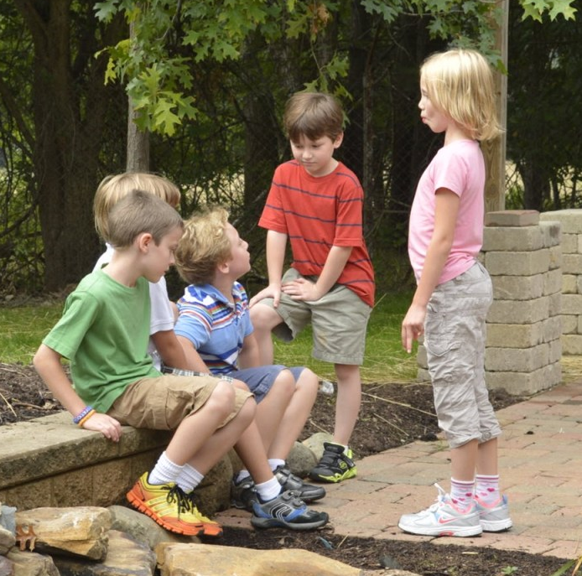
Take home point 1
Research confirms that students learn best -- and are healthiest -- when they are active participants partnering with talented faculty on work that matters.
We need programs that place students in the real world and engage them in solving authentic problems, for example, Entrepreneurship, Engineering & product design.
We need broad skill based opportunities where knowledge is naturally acquired.
hawken.edu/page/academics/mastery-school
Notes:
This is true from kindergarten to graduating high school

Slide 11
Take home point 2
The Paradigm Shifts Enabled by this new approach
Teacher as judge Teacher as guide/coach/facilitator
Breadth (mostly content) Depth (beyond just content)
Only a few paths for students Many more paths
One fixed pace, set by teacher Pace set by student needs

Slide 12

Take home point 3
By changing the way we assess at 16 & 18, we can change the way we approach what we do in school from the moment individuals’ ‘formal’ education begins!
It really is that radical!

Slide 13


So what about the UK right now?
Latymer Upper – London, were the first UK school to sign up to the MTC
Since then, Biddenham have signed up & will be developing the MTC at KS3
Others are likely to follow soon!

Slide 14


March 21st 2019
Douglas Archibald – Director of Whole Education will lead a session asking
‘How well are we preparing our young people for the future?’
Looking ahead:
David Price
mastery.org
educationforward.co.uk

Slide 15
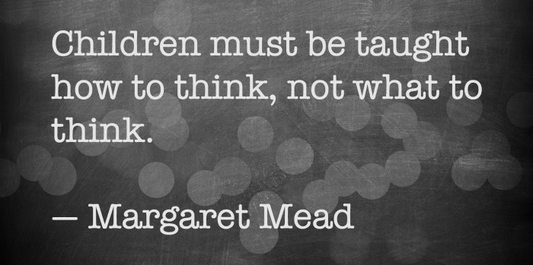

Slide 16
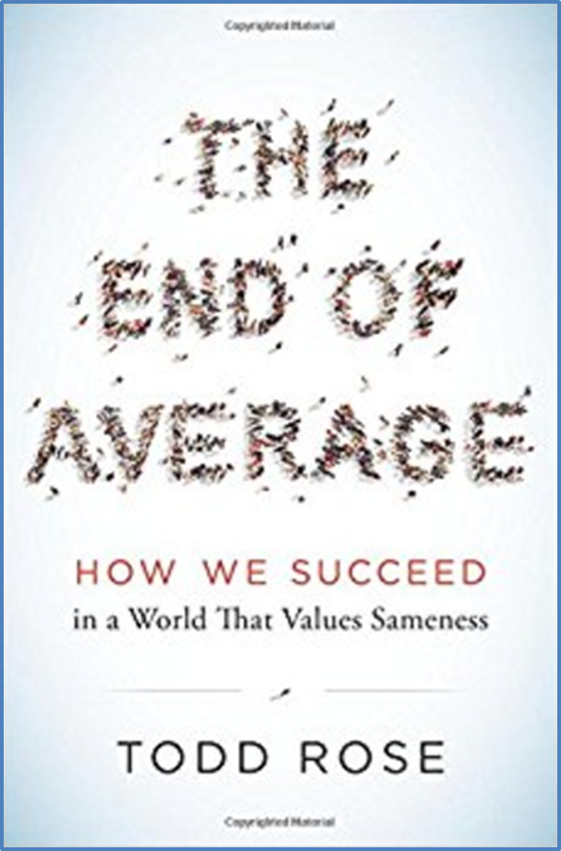
People are not standard…. curriculum, pedagogy, assessment, time, etc., should not be standardised.
We are all unique and should be treated as such.

Slide 17
This (the mastery transcript) is incredibly exciting news … This new development is a game changer. You have provided extraordinarily important leadership for an effort that could well prove to be a tipping point in the transformation of education!
– Tony Wagner
Expert in Residence, Harvard University Innovation Lab
Senior Research Fellow, Learning Policy Institute
mastery.org

Slide 18

This new approach imagined ….
https://youtu.be/Ym5vwSkk1Zo

