Slide 1
Hope and Creativity: Shaking up education in sub-Saharan Africa
Naomi Rouse

Slide 2
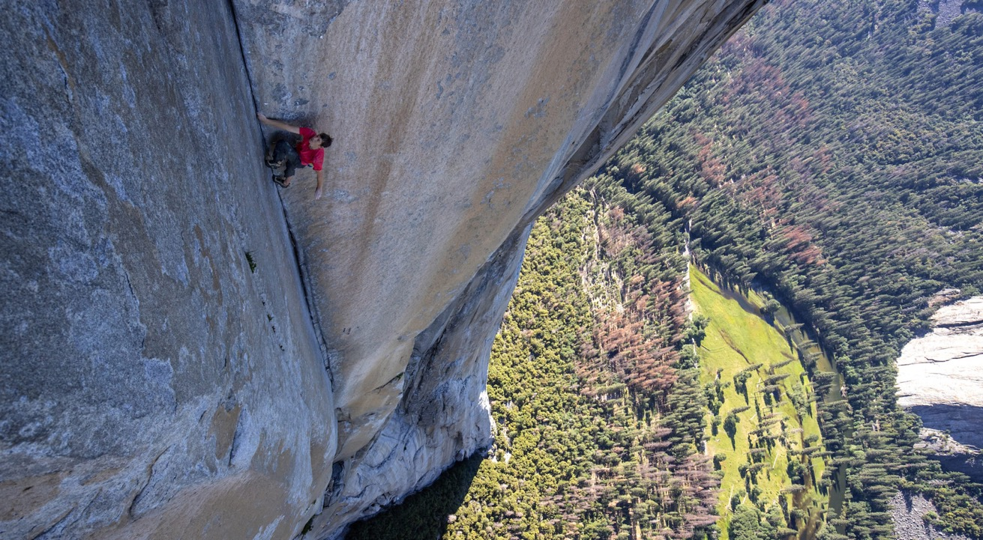

Slide 3
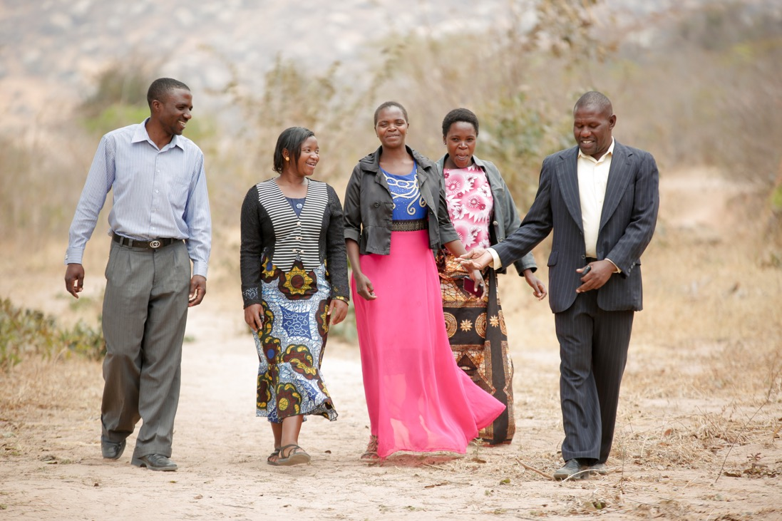

Slide 4
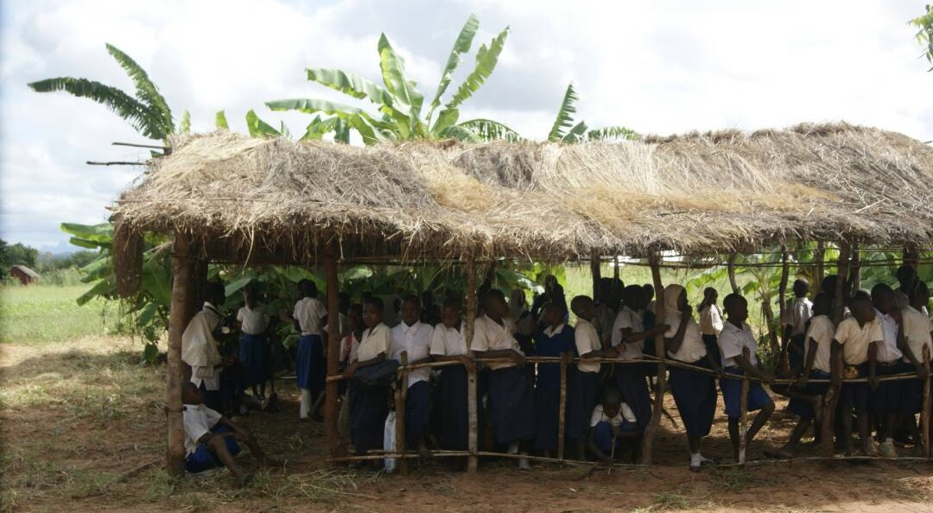
Notes:
What do you see?
I see – hope, commitment to education, uncertainty
Even by Tanzanian standards – very poor classroom
When young Tanzanian professionals working for education charities saw this picture they immediately pitched in and sent enough money for cement.

Slide 5
______ more people every 5 years

Slide 6
____ more children in primary school now than in 2015

Slide 7
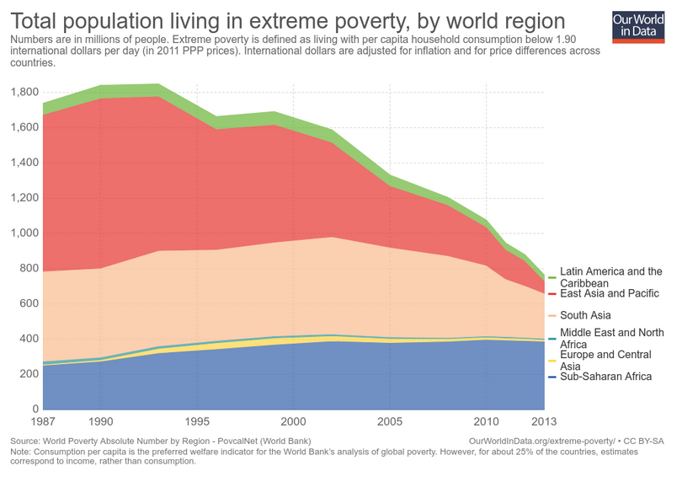

Slide 8
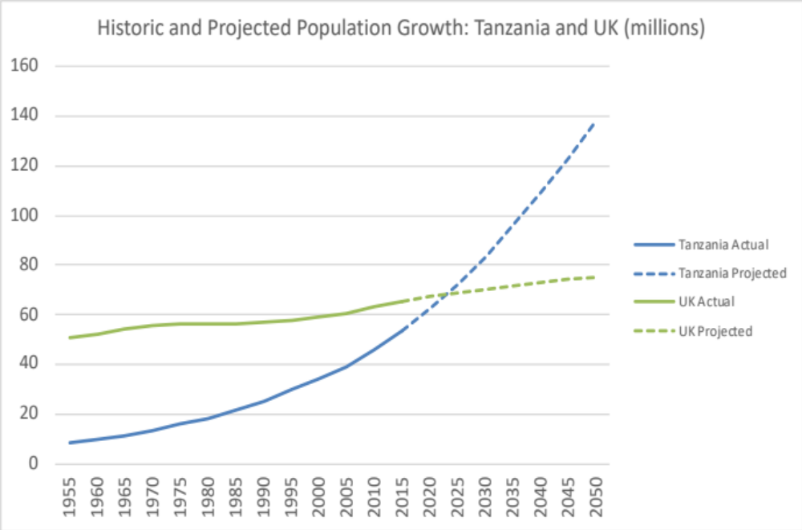

Slide 9
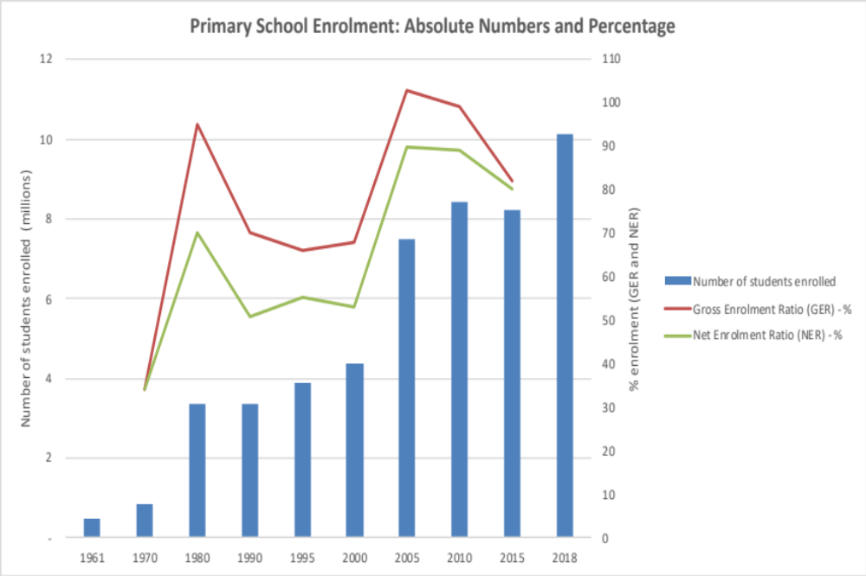

Slide 10
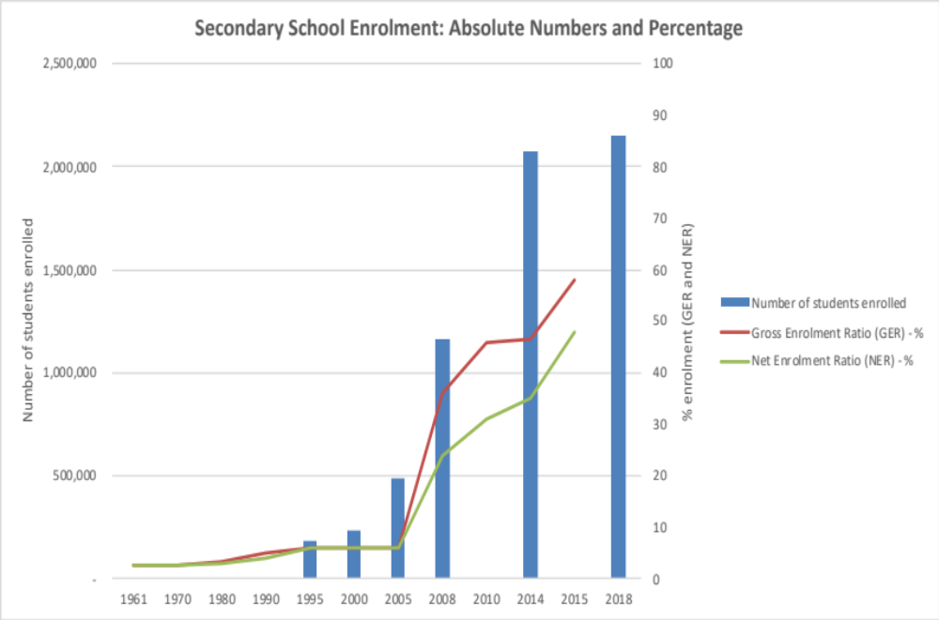

Slide 12
Camfed
How do you get the money to those who really need it?
How do you inject resources and ignite local action, rather than depress it and create dependency?

Slide 13
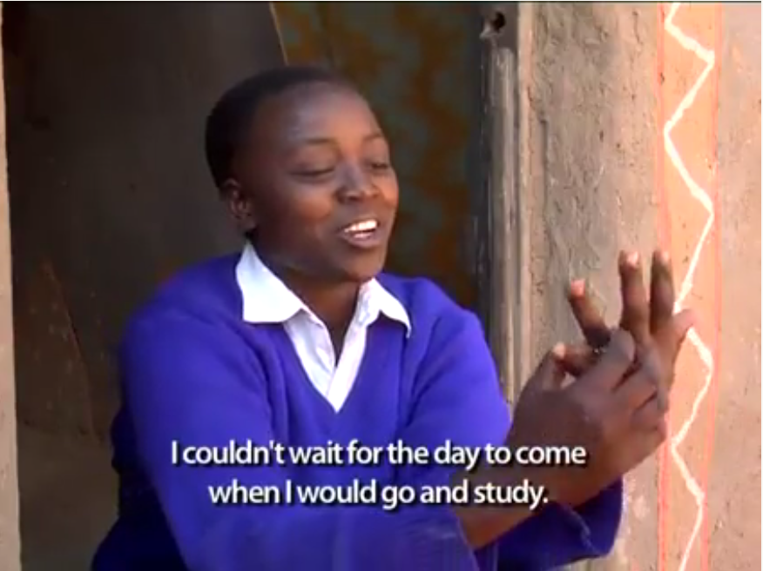

Slide 14
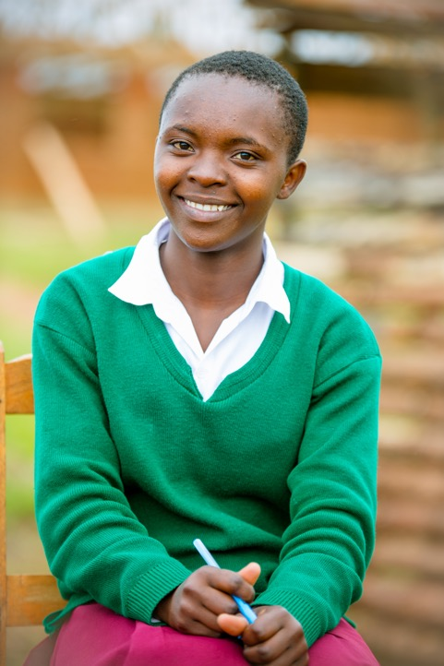

Slide 15
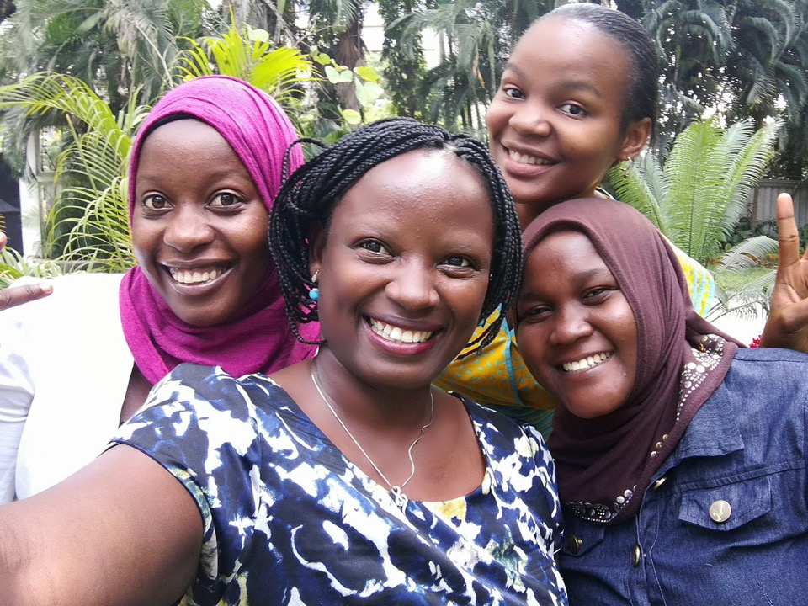

Slide 16
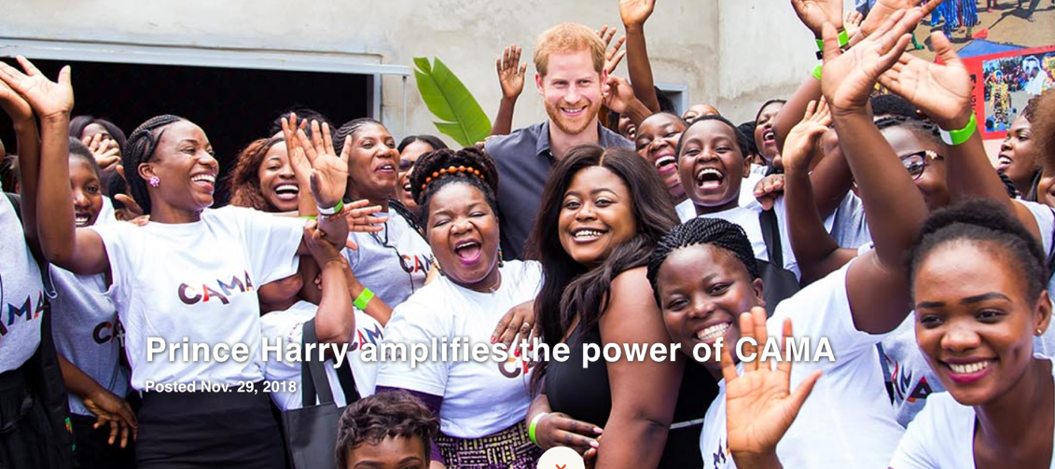

Slide 17
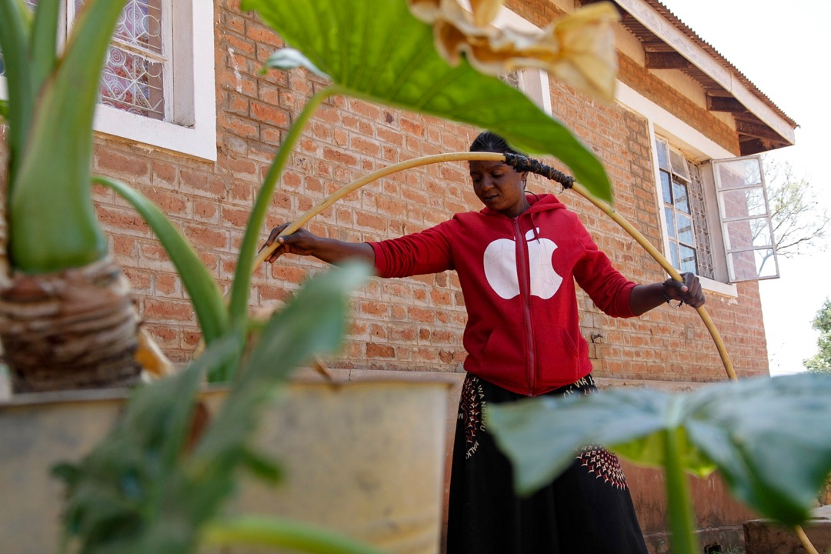

Slide 18
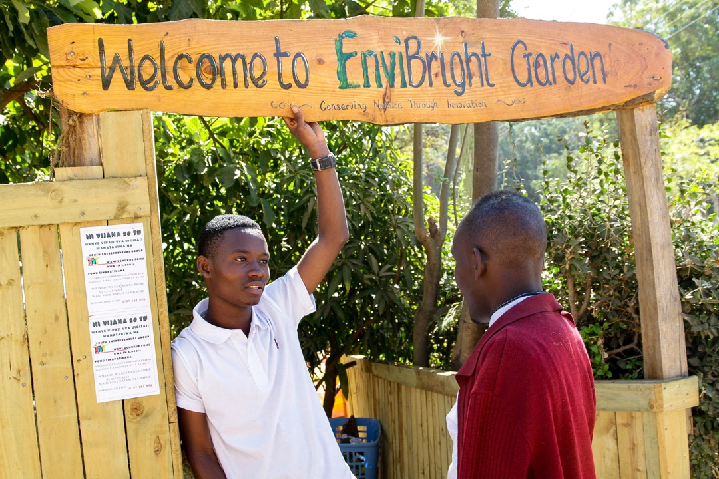

Slide 19
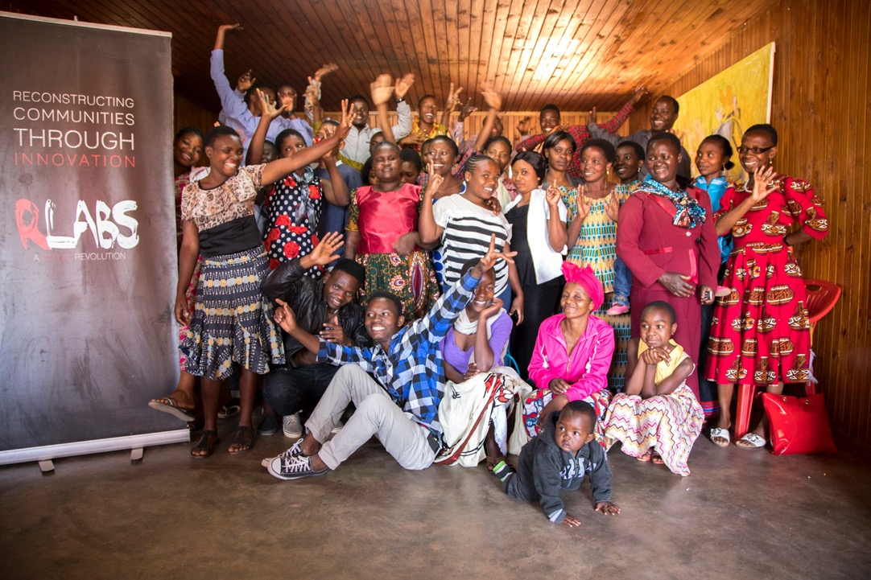

Slide 20
Links
www.camfed.org
https://camfed.org/latest-news/films/yacintas-story-lengths-i-went-get-education/
https://camfed.org/why-girls-education/stories/lydia-wilbard/
www.Rlabs.org
www.Rlabsuk.org (coming soon)
https://www.jasiri.blog/

