Slide 1
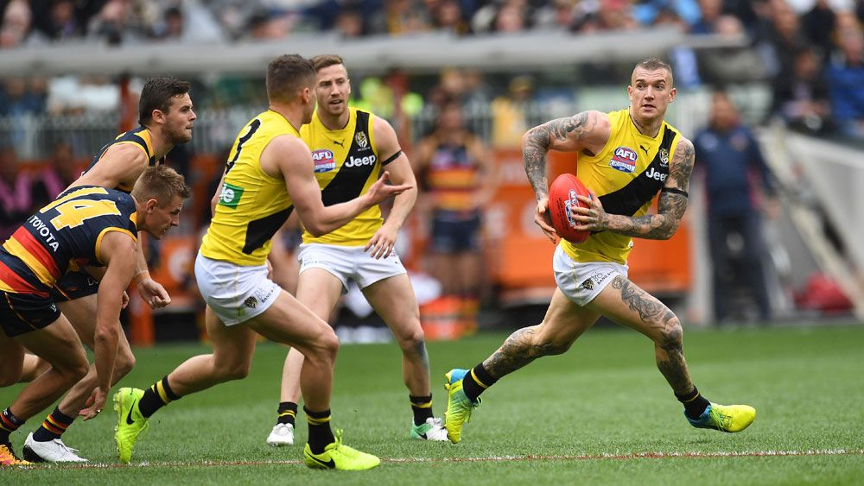
Working together – Biology and ESL
How subject specialists and language specialists are better together – a brief explanation of the work I did with our SEN Department:
How it started
What we both learned
Where it went
The many benefits of team teaching
Time and space

Slide 2
How to use the right stuff to make your whatsits get things
How to use the correct academic language to make your answers get full marks

Slide 3
Q4(c).Describe the advantage to the human body of producing memory cells (2)
The body can produce things that kill the harmful invading thing faster. (0)
White blood cells produce antibodies to kill the pathogen faster. (2)

Slide 4
Q5(c).Use you knowledge of enzymes to explain why blood is slow to clot at 45⁰C (2)
When it gets too hot the enzymes break down and die. The enzymes stop working properly. (0)
At higher temperatures enzymes become denatured. The active site changes shape so the substrate no longer fits. (2)

Slide 5
Q5(d). Suggest what happens in the heart muscle cells when the coronary artery is blocked (4)
The heart receives less blood so has less energy. The cells stop functioning properly and eventually die. (0)
Heart muscle cells receive less oxygen and glucose. There is less aerobic respiration and more anaerobic respiration. Lactic acid is produced so the pH falls. Low pH causes enzymes to denature. (4)

Slide 6
