Slide 1
Computing and How the Fellowship Helped Me.
By Dan Veal
Twitter: @Mr_Veal1
Email: dan.veal@brickhillprimary.co.uk
Notes:
Hi, I’m Dan Veal and among a few roles I am currently the ICT/Computing Coordinator and Year 1 Teacher at Brickhill Primary School.
My little talk is in two parts, the first is Computing in Key Stage 1 and how we lay the foundations at Brickhill.

Slide 2



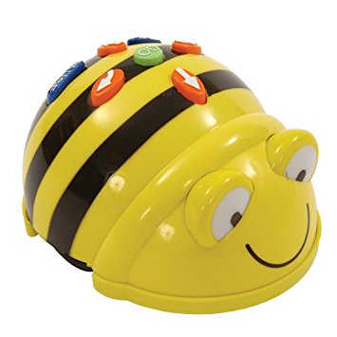


Computing in Key Stage 1
Notes:
I inherited the role of Computing Coordinator this September, along with the title I inherited a complete mess. The only planning we had was a single piece of single sided paper that had a general guide for using Microsoft Office and the phrase “Use Purple Mash for Coding”.
So I took it upon myself to write a scheme of work for the school, more of which I will get to in part 2.
Here are some images of the software and hardware we now use in KS1.
Purple Mash – Great software for KS1, it has many different tools available for nearly every subject (a good way to get cross curricula links in with Computing).
Hour of Code – Good for Key Stages 1-3 as each activity is aimed at different year groups and they can be coded with blocks or javascript. My classes favourite is Minecraft, where they get to make Minecraft and understand how it works.
Pivot Animator – a fun way to show how animation works with frame by frame images. They love making their own avatars and creating a story.
MS Office – Historically these skills would be for the older children, however our Year 1 children learn the basics of Word and Publisher. These skills are built upon in Year 2 and they learn the basics of Powerpoint.
Cbeebies – I tend to use the games as lessons in the Autumn term to teach basic mouse and keyboard skills.
The only hardware listed: Beebots – These are the foundation to understanding programming. The children have to write an algorithm to guide the beebot through a maze, they program it in and then debug mistakes.

Slide 3
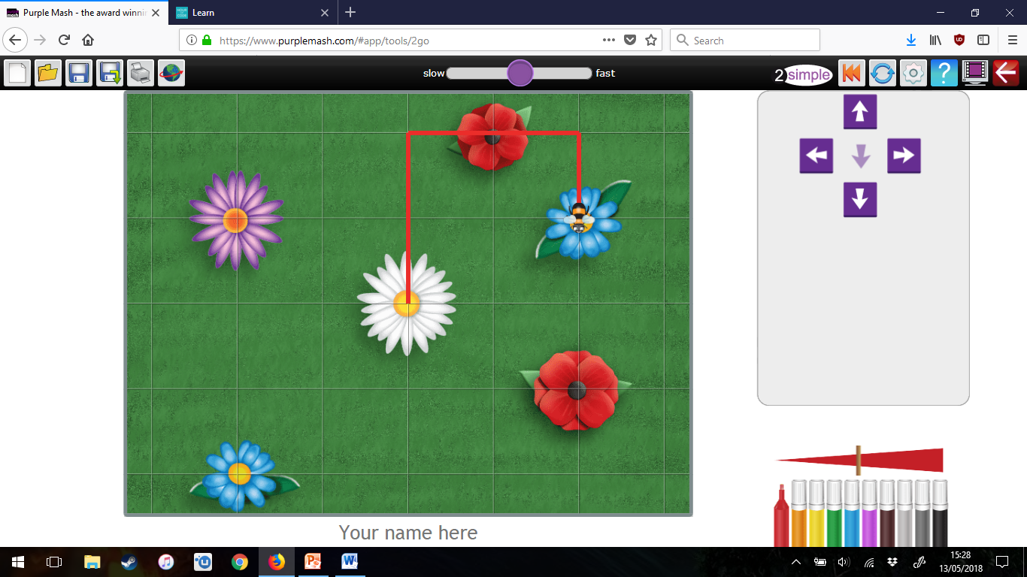
Computing in Key Stage 1
Purple Mash – 2 go
Notes:
Purple Mash is the main tool used in Key Stage 1 for coding.
After the children have used beebots they get introduced to 2Go on Purple Mash, here is a screenshot.
They start with these basic controls similar to the Beebot, which can be made challenging by changing the arrows to different control methods: Including diagonal movement and turning.

Slide 4
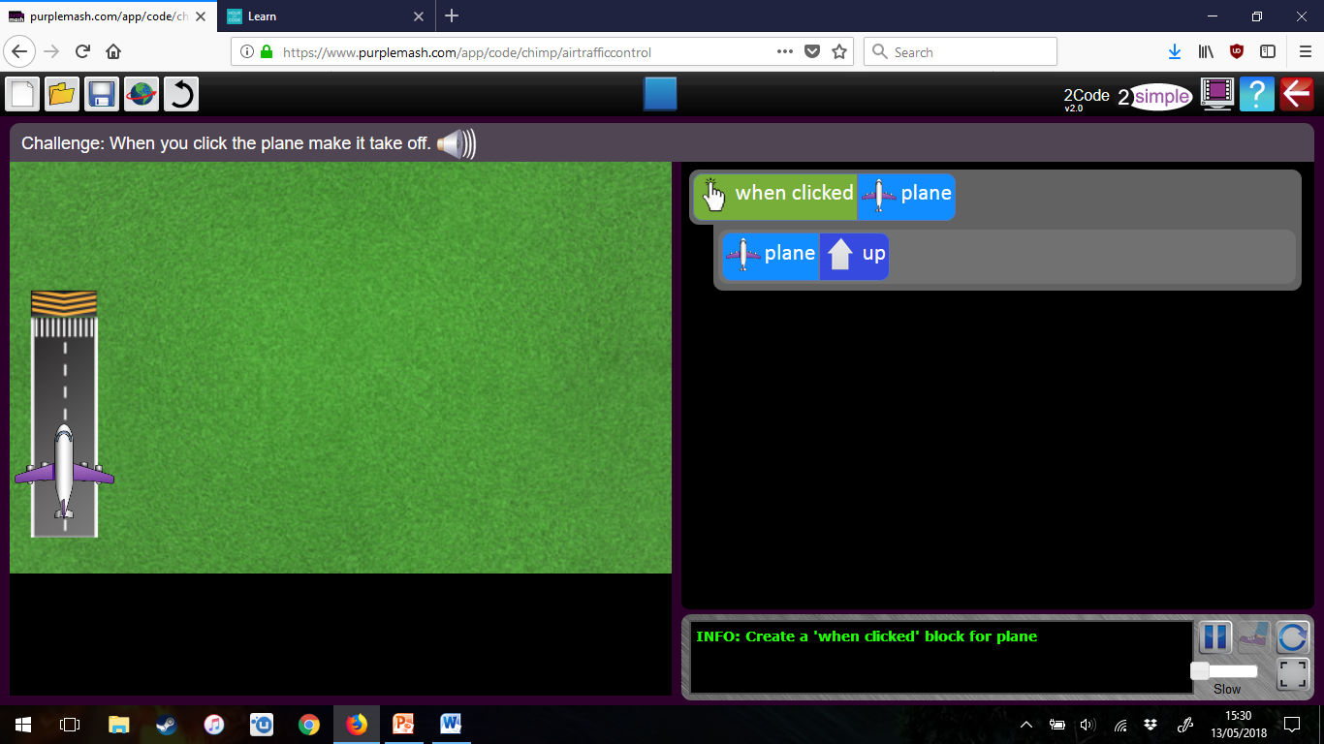
Computing in Key Stage 1
Purple Mash – 2 code
Notes:
Then we introduce 2Code
2Code is a block based coding software, I would recommend it for Year 1 up to Year 3 then depending on abilities maybe Year 4.
This is a screenshot of Air Traffic Control (A Year 1 challenge).
This is task 1, they have to use the blocks to make it so that when you click on the airplane the plane “takes off”. The tasks then introduce more aircraft and then leads to a “Debug Challenge”.
At Brickhill we have said that each section on 2Code is a Year Group, so Chimp (the easiest) is for Year 1.

Slide 5
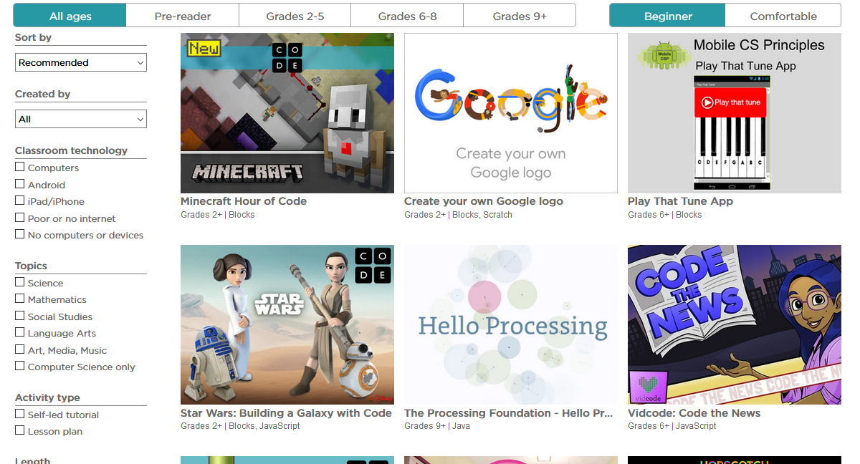
Computing in Key Stage 1
Hour of Code
Notes:
My main criticism of 2Code is that the children only get given the blocks they need, so I will use Hour of Code.
Hour of Code usually has at least one red herring which the children don’t need in their code. Which is great for getting them ready for using Scratch in Key Stage 2.

Slide 6
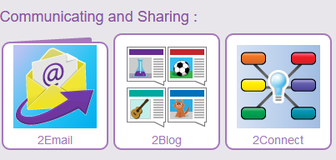
Computing in Key Stage 1
Social Media – Purple Mash
Notes:
Social Media is a large part of life today, it is hard to find someone that isn’t on Social Media. So we need to education the children how to use it safely.
In Key Stage 1 we use Purple Mash, 2Email is a great introduction to emailing. It has pre-set tasks where the children can get automatic responses, or if they have earned your trust they can email each other (which goes through yourself to approve their emails).
2Blog is a blog where they can post their work for classmates to see.
2Connect is mainly used to make brain clouds, however there is an option to work collaboratively.

Slide 7

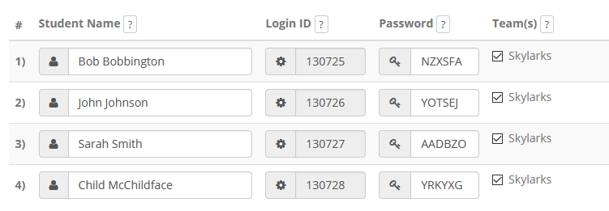
Computing in Key Stage 1
Social Media – Twiducate
Notes:
Twiducate, I have used it with Year 1 but it does work better in Key Stage 2. It is basically twitter controlled by the teacher, you set up a class and get log in details.

Slide 8
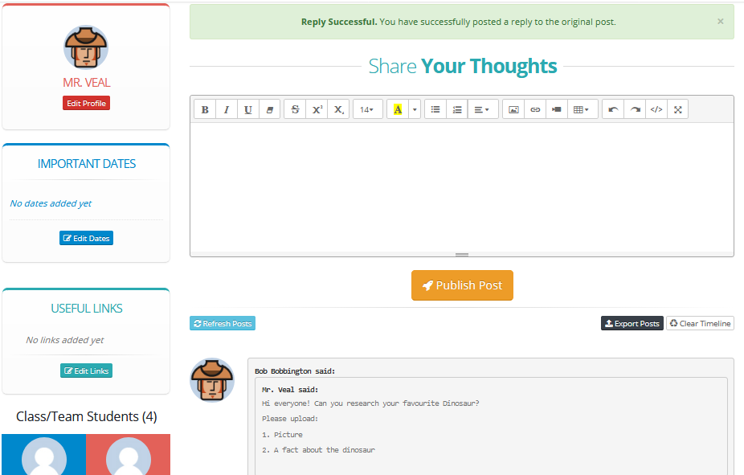
Computing in Key Stage 1
Social Media – Twiducate
Notes:
You then distribute these to the children, where they can then see each others work.
As you can see it is laid out like Twitter, we have used it to share images and facts of dinosaurs.
I could talk for a while about e-safety as that is something I have pushed a lot, so much so it was mentioned in our recent Ofsted!

Slide 9

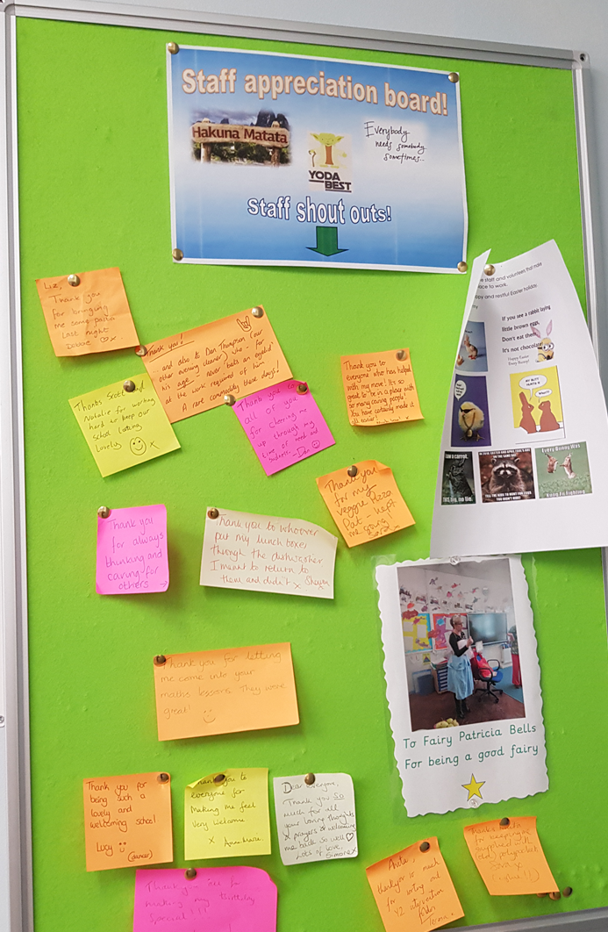
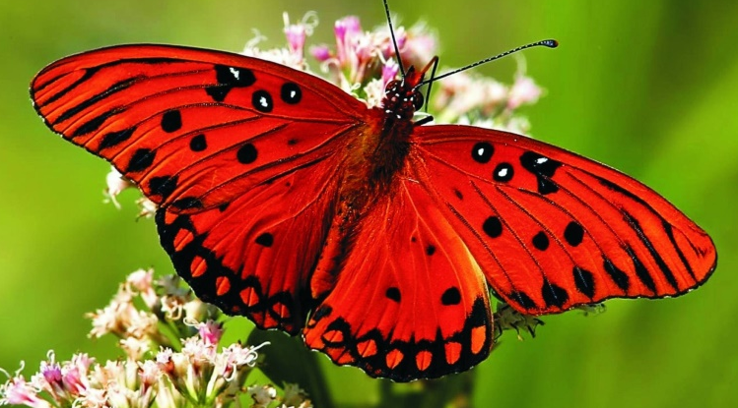
How the fellowship helped me and Brickhill Primary School.
Notes:
I’ll start with the ego and talk about myself as mentioned earlier I wrote a scheme of work for my school, from talking to people here I was pointed in Jacqs direction who was able to give me some pointers and contact details of others I could ask for advice. It was through this networking that I was able to write an effective scheme for all year groups.
Brickhill School! The main thing that has been implemented within the school is the Butterflies. The staff needed a way to feel appreciated. So from the Butterflies I helped to implement a staff appreciation board. This is in our staffroom and has loads of lovely things spread between the staff and has made it easier for all to say thanks.
Something that kicked off within my computing staff meetings is sharing good practice, I make an agenda point of this. Since other leaders are now including it within their meetings.

Slide 10
Dan Veal
Twitter: @Mr_Veal1
Email: dan.veal@brickhillprimary.co.uk

