Slide 1
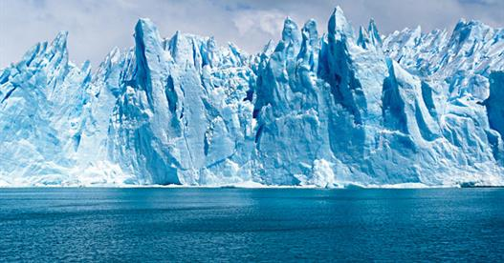
Ice Breaker

Slide 2
Why were you given your name?
Who chose your name?
What is in a name?
Do you have a nickname?
Do you like it?
What is it shortened to?

