Slide 1
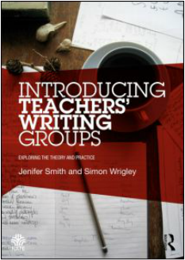
The occupation of writing issues of agency, ownership and orientation within the teaching of writing
Simon Wrigley, outreach director
National Writing Project (UK)()
AEFP Writers’ forum,
Gateway building,
University of Bedfordshire
Thursday 2 November, 2017
NATE ITE symposium

Slide 2
50 years research on writing: what have we learnt?
When students attend to improving content and purpose, discussing details and feelings, writing improves more than when they attend to the forms and structures.
(George Hillocks, Chicago)
To grow, young writers need a teacher who cares about what they want to say, and low stakes writing opportunities in which they can invest emotionally.
(Peter Elbow, Massachusetts)
Youtube nwp.org.us conversation 2008

Slide 3
“Accountability is what’s left when responsibility is taken away.”
Pasi Sahlberg, Finnish Education Director 2013

Slide 4
Authors, authority and authenticity
‘If you limp around long enough in someone else’s language, you may eventually learn to walk in it.’
James Britton 1982
‘Classrooms would be transformed if pupils wrote what they wanted to write, rather than what their teachers told them to write.’
Harold Rosen 1969

Slide 5
What drives NWP (UK)?
Participation
The convictions that:
writing has a privileged place in understanding the human condition
writing deepens education when it attends both the affective and the cognitive
writing helps us to understand the world in our selves and negotiate our place in the world
writing is a creative act that can bring joy and affirmation
... and Resistance
The convictions that
teachers should be agents of reform
teachers need the power and nurture of writing communities
writing is distorted by the prominence given to the writing product at the expense of learning and inclusion
by re-orienting ourselves as writing practitioners and learners everyone benefits

Slide 6
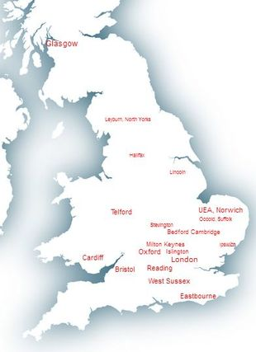
NWP teachers’ writing groups in the UK
November 2017

Slide 7
What have we learnt since the start of the project in 2009?
Writing alongside others motivates, gives confidence and leads to discoveries.
Regular writing strengthens voice and agency – it develops a ‘hinterland’ for the writing.
teacher.
Writing groups develop a writing habit and help teachers find ways to use writing for learning rather than proof of learning.of learning.
Teachers feel restored and enriched by collaborative creativity.
Writing groups are laboratories in which the fuller ‘affordances’ of writing can be explored.
Teachers who attend writing groups open up the writing process to young writers. They foster independence and resilience.

