Slide 1
Introduction to Flipboard
‘The one place for all your interests: MAGAZINES YOU MAKE AND SHARE
Collect great articles, videos and photos into digital magazines you can share and take anywhere.’
Disclaimer- just sharing a resource – no financial gain from Flipboard is expected!

Slide 2
Flipboard app for your laptop and electronic devices
‘Flipboard is your personal magazine, the single place for all your interests, used by millions of people everyday. Reading, collecting and sharing stories you want to read, or reserve to read later…..when you have time ….or when you need that article!’
It can be linked to your Twitter account (as I do) or Facebook (although I don’t do that myself) and also from searching or following other Flipboard stories e.g. Cover Stories directly from the Flipboard site.

Slide 3
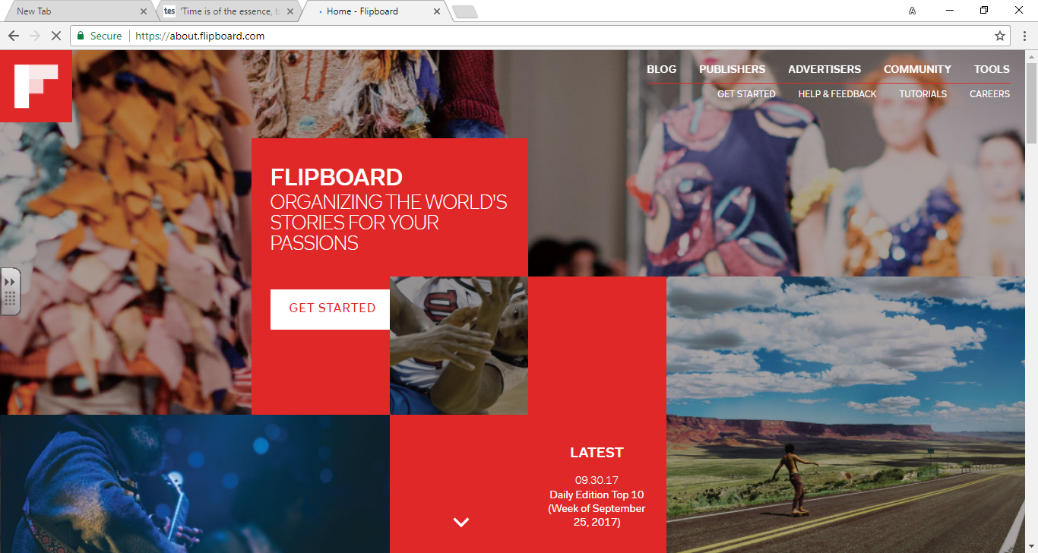

Slide 4
Setting up Flipboard- is FREE!
Search for Flipboard app
https://flipboard.com/
Select the download for your device- input email address and set up a password
If you already have Twitter/ Facebook you can select to link these to Flipboard too.
Once set up- set up your own Magazines e.g. Teacher’s Corner.
You can also search for particular magazines you want to follow, make comments on or share e.g. Education.

Slide 5
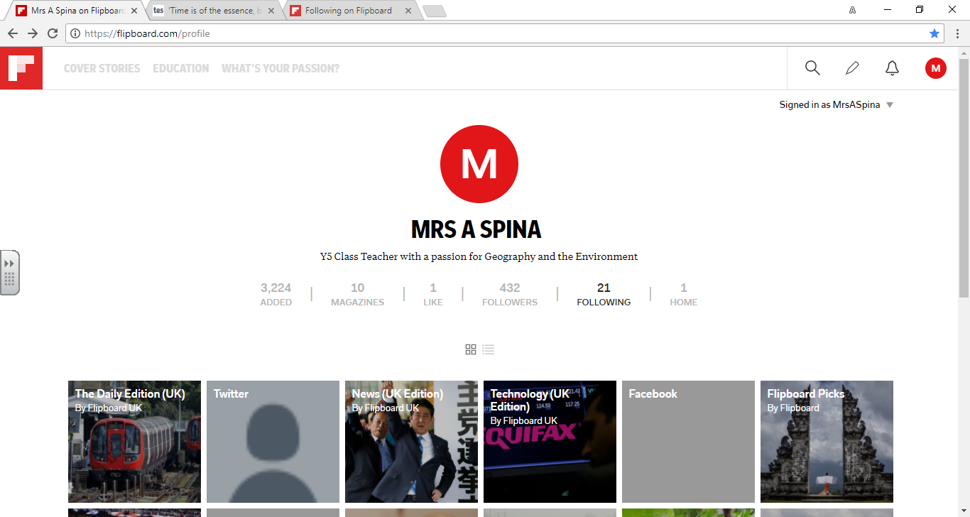

Slide 6
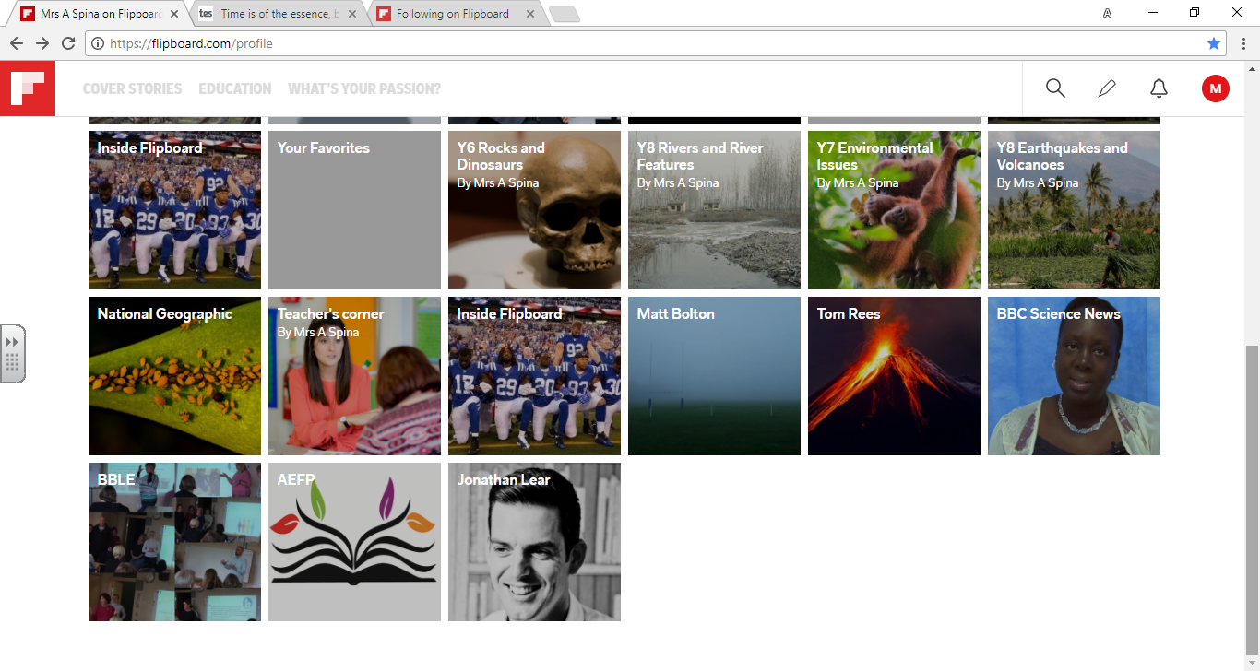

Slide 7
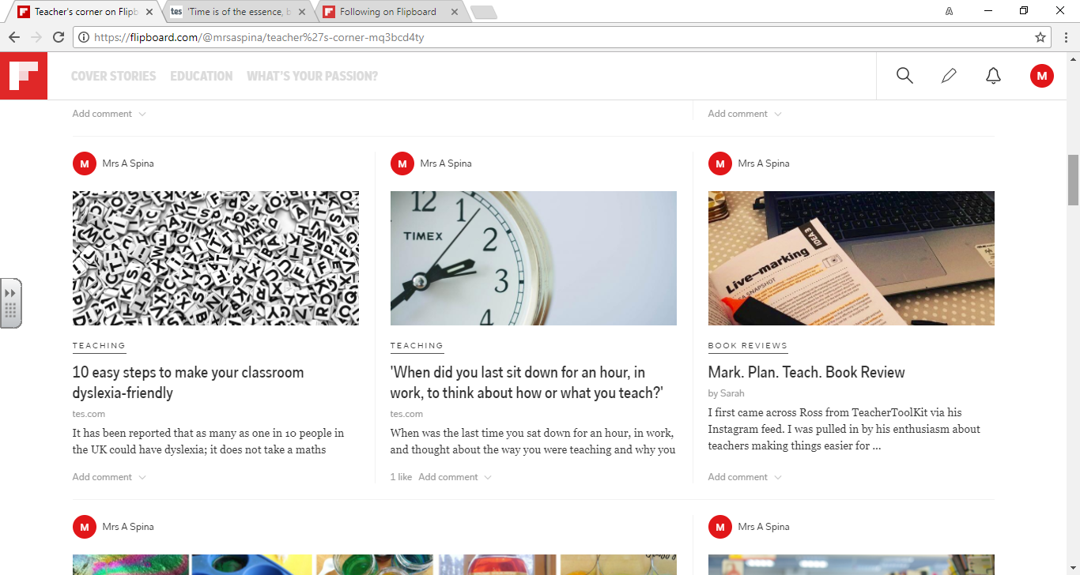

Slide 8
Example of an article I ‘flipped’ this weekend:
https://www.tes.com/news/school-news/breaking-views/when-did-you-last-sit-down-hour-work-think-about-how-or-what-you
Interest in professional development within the profession has never been higher among British teachers. You only have to look at the number of teachers on Twitter who share what they are reading at the moment to know that the desire to reflect on and improve one’s practice has never been higher. However, the time to actually do so has never been more restricted.
There has been a misconception that always doing something leads to greater productivity. This may well be the case in big business. But education is different. Education is not simply making as many products as possible and selling as many of them as possible. The “product” of learning requires great “pre-thought” and plenty of reflection too.
The idea that classroom teaching is teaching needs challenging. Teaching is merely the cherry on the cake of (hopefully) a cycle of reflection and planning and a gradual building of subject knowledge and pedagogical options over time.

Slide 9
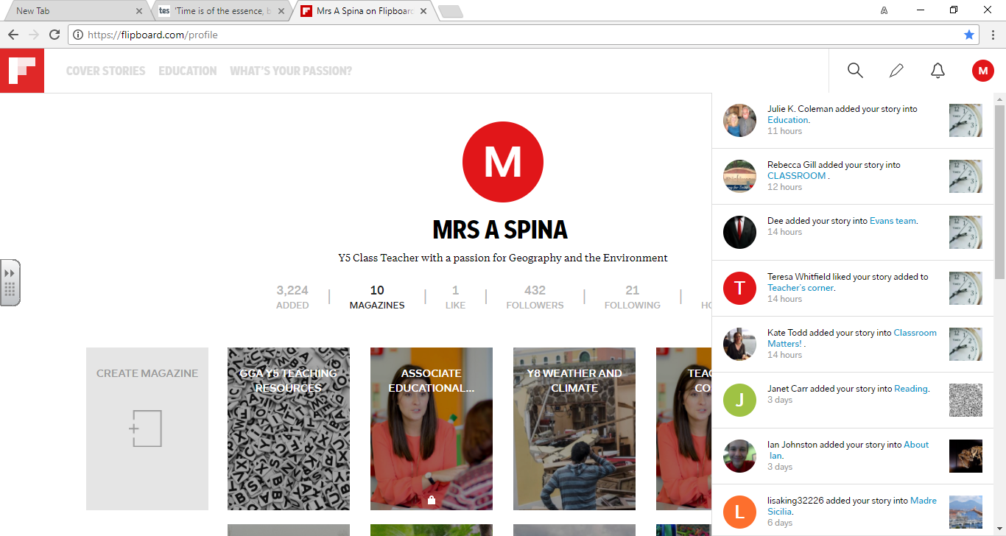

Slide 10
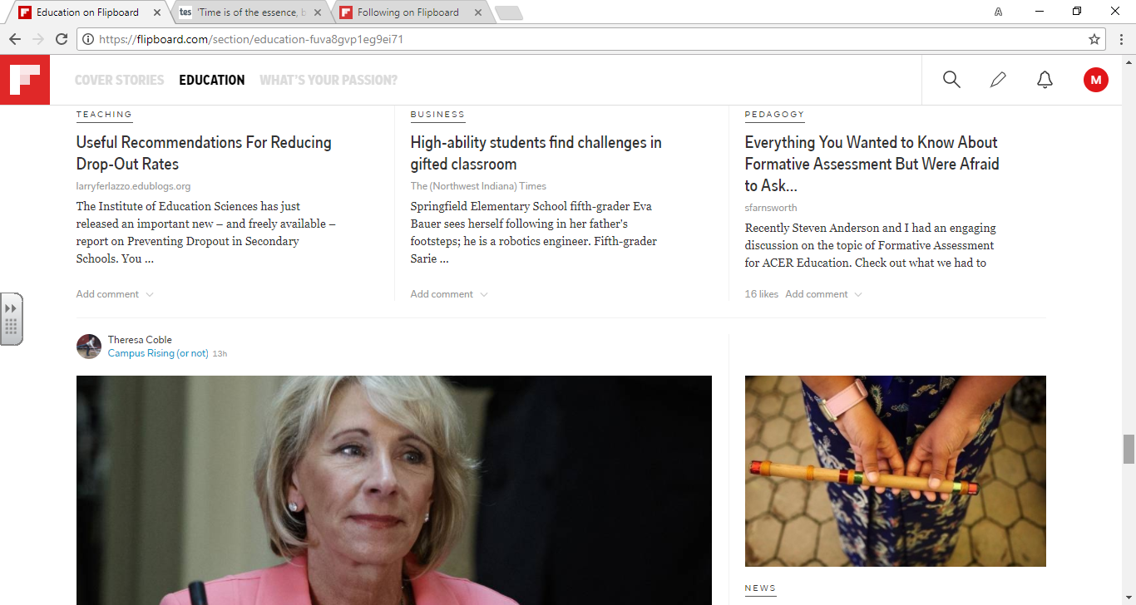

Slide 11
Since starting Flipboard- I have made time to read articles, reflect on my teaching and collated resources in an accessible format to support my teaching. Hopefully I’ve helped a few other teachers by sharing the articles I have found interesting.
You can add likes and comments etc.- although I haven’t delved into that side of Flipboard.
Give it a go………..

